Slide 1


Ayush Maurya
MAY 2022

Slide 2
Outline
Executive Summary
Introduction
Methodology
Results
Conclusion
Appendix
2

Slide 3
Executive Summary
Summary of methodologies
Data collection
Data wrangling
EDA with data visualization
EDA with SQL
Building an interactive map with folium
Building a dashboard with plotly
Dash
Predictive analysis (classification)
Summary of all results
Exploratory data analysis
results
Interactive analytics demo in screenshots
Predictive analysis results
3

Slide 4
INTRODUCTION
Project background and context:
I predicted if the Falcon 9 first stage will land successfully. SpaceX advertises falcon 9 rocket launches on its website, with cost of 62 million dollars, other providers cost 1bout 15 million dollars each. Much of the savings is because space x can reuse the first stage. This means that, if we can predict if the first stage will land, we can predict the cost of the launch.
Problems you want to find answers:
▶ What influences if the rocket will land successfully?
▶ The effect each relationship with certain rocket variables will impact in determining the success rate of a successful landing.
▶ What conditions does spaceX have to achieve to get the best results & ensure the best rocket success landing rate.
4

Slide 5

Section 1
5

Slide 6
Methodology
Executive Summary
Data collection methodology:
We used : SpaceX Rest Api &
( Web Scrapping) from Wikipedia
Perform data wrangling
We transformed data machine learning using
One Hot Encoding data fields for machine learning and dropping irrelevant columns.
Perform exploratory data analysis (EDA) using visualization and SQL
Perform interactive visual analytics using Folium and Plotly Dash
Perform predictive analysis using classification models
How to build, tune, evaluate classification models
6

Slide 7
Data Collection
▶ Describe how data sets were collected.
▶ Usng the SpaceX Rest Api because it will gives us the data about launches,
landing specifications, landing outcome and info about the rocket used.
▶ We also used the webscraping method on the Wikipedia site.
▶ You need to present your data collection process use key phrases and
flowcharts
Returns spaceX data in jason
SpaceX Rest Api
Normali ze data

Slide 8
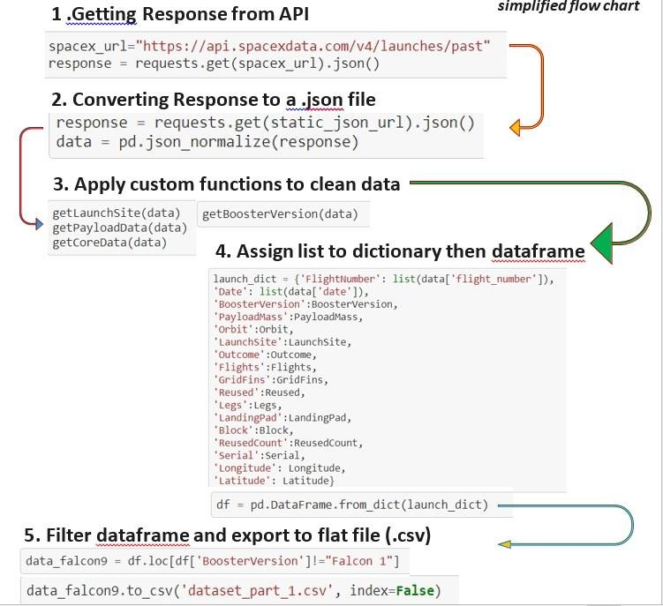
Data Collection – SpaceX API
▶ Present your data collection with SpaceX REST calls using key phrases and flowcharts

Slide 9
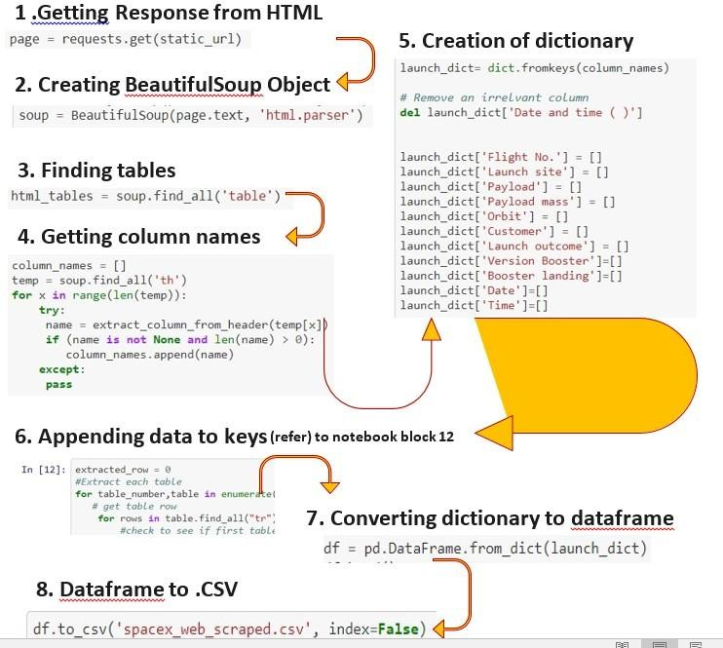
Data Collection - Scraping
▶ Present your web scraping process using key phrases and flowcharts

Slide 10
▶ DATA WRANGLING
▶ Describe how data were processed
▶ In the data set, there are several different cases where the booster did not land successfully. Sometimes a landing was attempted but failed due to an accident; for example, True Ocean means the mission outcome was successfully landed to a specific region of the ocean while False Ocean means the mission outcome was unsuccessfully landed to a specific region of the ocean. True RTLS means the mission outcome was successfully landed to a ground pad False RTLS means the mission outcome was unsuccessfully landed to a ground pad. True ASDS means the mission outcome was successfully landed on a drone ship False ASDS means the mission outcome was unsuccessfully landed on a drone ship.

Slide 11
EDA with Data Visualization
▶ Summarize what charts were plotted and why you used those charts.
▶ Bar gragph : Mean Vs Orbit. Its easiers to compare different groups at a
glance.
▶ Line Graph : Success Rate Vs Year. They show data variables and trends very clearly and can help to Mke predictions about the reaults of data not yet recorded.
▶ Scatter plot: flight number vs payload
▶ Flight number vs launch site
▶ Orbit vs flight number

Slide 12
EDA with SQL
Using bullet point format, summarize the SQL queries you performed
▶ Names of unique launch sites in space mission
▶ Displayed 5 records whee launch sites begin with the string KSC
▶ Displayed the total payload mass carried by bossters launched by NASA (crs)
▶ Displayed average payload mass carried by booster version F9 v1.1
▶ Listing the date where the successful and failure mission outcomes
▶ Listing the total names of booster versions which have carried the maximum payload mass.
▶ Listed the records which will display the month names, successful landing outcomes in
ground pad, booster version, launch site

Slide 13
Build an Interactive Map with Folium
▶ To visualize the Launch Data into an interactive map. We took the Latitude and Longitude Coordinates at each launch site and added a Circle Marker around each launch site with a label of the name of the launch site.
▶ We assigned the dataframe launch_outcomes(failures, successes) to classes 0 and 1 with Green and Red markers on the map in a markercluster ()
Using Haversine’s formula we calculated the distance from the Launch Site to various landmarks to find various trends about what is around the Launch Site to measure patterns. . Lines are drawn on the map to measure distance to landmarks.
▶ Example of some trends in which the Launch Site is situated in.
▶ •Are launch sites in close proximity to railways? No
▶ •Are launch sites in close proximity to highways? No
▶ •Are launch sites in close proximity to coastline? Yes
▶ •Do launch sites keep certain distance away from cities? Yes

Slide 14
Build a Dashboard with Plotly Dash
▶ Summarize what plots/graphs and interactions you have added to a dashboard
▶ The dashboard is built with Flask and Dash web framework.
▶ GitHub Link to source code - display relative proportions of multiple classes of data.
▶ - size of the circle can be made proportional to the total quantity it represents

Slide 15
Predictive Analysis (Classification)
▶ BUILDING THE MODEL:
▶ Loaded the dataset into numpy and pandas
▶ Tranformed the data
▶ Split data into training and test sets
▶ Viewed how many samples are there
▶ Choose the machine learning to use
▶ Set the parameters and algorithms to GridSearchCV
▶ Fit our datasets into the GridSearchCV objects and train our dataset.
▶ EVALUATING THE MODEL:
▶ Considered the accuracy for each model
▶ Got tuned hyperparameters for each algorithm
▶ Plot confusion matrix.

Slide 16
Results
Exploratory data analysis results
Interactive analytics demo in screenshots
Predictive analysis results

Slide 17

Section 2

Slide 18
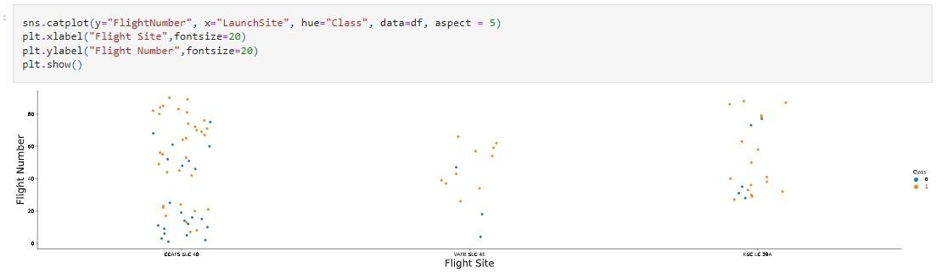
Flight Number vs. Launch Site
▶ Show a scatter plot of Flight Number vs. Launch Site

Slide 19
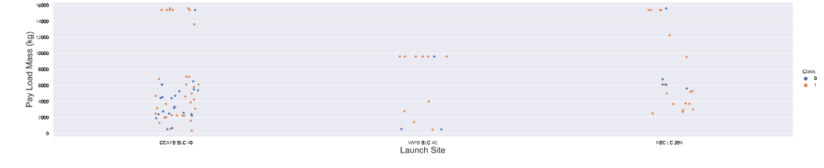
Payload vs. Launch Site
▶ Show a scatter plot
of Payload vs. Launch Site

Slide 20
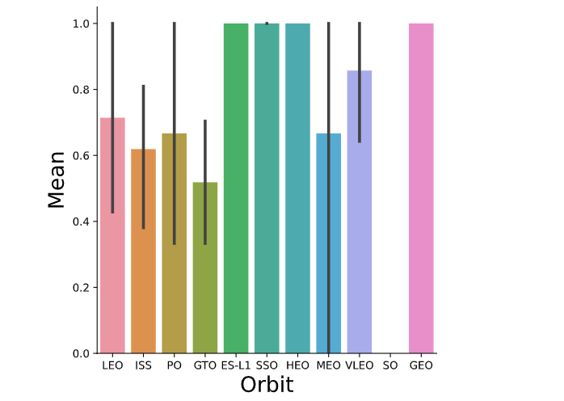
Success Rate vs. Orbit Type
▶ Show a bar chart for the success rate of each orbit type
▶ Orbit GEO, HEO, ES-L1 has the highest success rate.

Slide 21
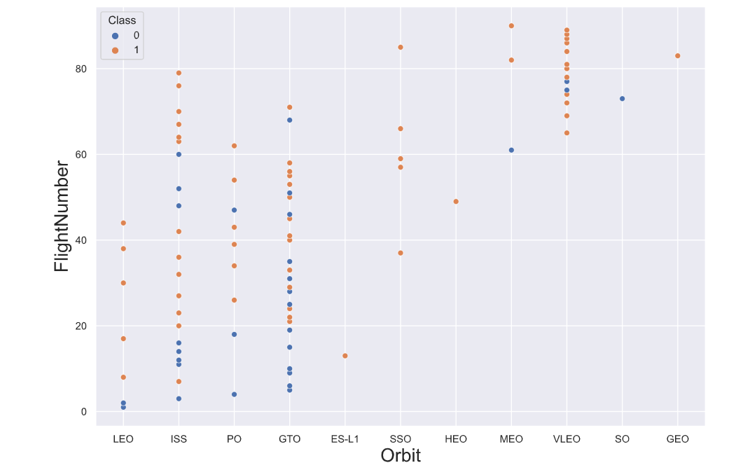
Flight Number vs. Orbit Type
▶ Show a scatter point of Flight number vs. Orbit type
▶ In the LEO orbit, the success seems related to the number of flights, meanwhile, there is no obvious relationship between flight number when in GTO orbit.

Slide 22
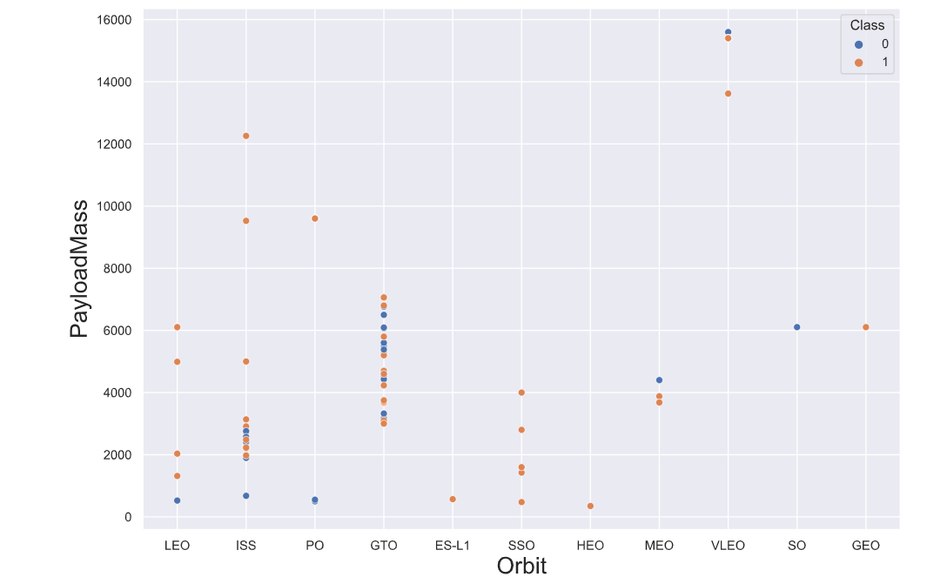
Payload vs. Orbit Type
▶ Show a scatter point of payload vs. orbit type
▶ I noticed that the heavy payloads have a negative influence on GTO orbits and positive influence on GTO and Polar LEO (ISS) orbits

Slide 23
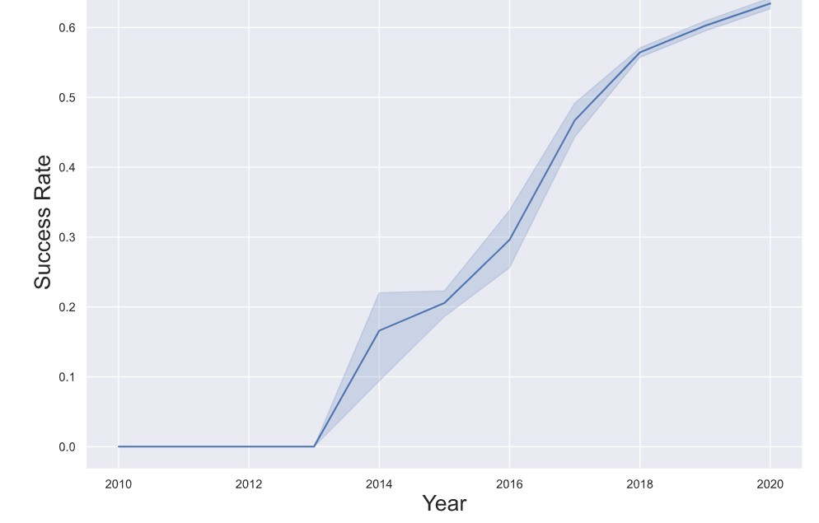
Launch Success Yearly Trend
▶ Show a line chart of yearly
average success rate
▶ Seeing that the success rate since 2013 kept increasing till
▶ 2020.

Slide 24
All Launch Site Names
']
▶ Find the names of the unique launch sites:
▶ Select DISTINCT launch_site from tblSpaceX
▶ Present your query result with a short explanation here
▶ 'CCAFS LC-40', 'CCAFS SLC-40, ', 'CCAFSSLC-40, 'KSC LC-39A', 'VAFB SLC-4E']

Slide 25
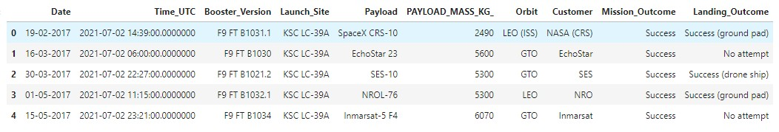
Launch Site Names Begin with 'CCA'
▶ Find 5 records where launch sites begin with `CCA`
▶ select TOP 5 * from tblSpaceX
▶ Present your query result with a short explanation here

Slide 26
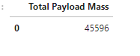
Total Payload Mass
▶ Calculate the total payload carried by boosters from NASA
▶ select SUM(PAYLOAD_MASS_KG_) TotalPayloadMass from tblSpaceX
where Customer = 'NASA (CRS)'",'TotalPayloadMass’
Present your query result with a short explanation here

Slide 27
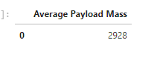
Average Payload Mass by F9 v1.1
▶ Calculate the average payload mass carried by booster version F9 v1.1
▶ select AVG(PAYLOAD_MASS_KG_) AveragePayloadMass from tblSpaceX where
Booster_Version = 'F9 v1.1'
▶ Present your query result with a short explanation here

Slide 28

First Successful Ground Landing Date
▶ Find the dates of the first successful landing outcome on ground pad
▶ select MIN(Date) SLO from tblSpaceX where Landing_Outcome =
”Success (drone ship)”
▶ Present your query result with a short explanation here

Slide 29
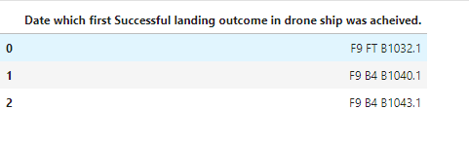
Successful Drone Ship Landing with Payload between 4000 and 6000
▶ List the names of boosters which have successfully landed on drone ship and had payload mass greater than 4000 but less than 6000
▶ select Booster_Version from tblSpaceX where Landing_Outcome = 'Success
(ground pad)’AND Payload_MASS_KG_ > 4000 AND Payload_MASS_KG_ < 6000
Present your query result with a short explanation.

Slide 30
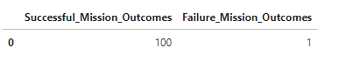
Total Number of Successful and Failure Mission Outcomes
▶ Calculate the total number of successful and failure mission outcomes
▶
SELECT(SELECT Count(Mission_Outcome) from tblSpaceX where Mission_Outcome LIKE '%Success%’) as Successful_Mission_Outcomes,
(SELECT Count(Mission_Outcome) from tblSpaceX where Mission_Outcome LIKE '%Failure%’) as Failure_Mission_Coutcomes
Present your query result with a short explanation.

Slide 31
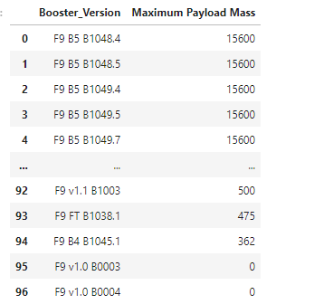
Boosters Carried Maximum Payload
▶ List the names of the booster which have carried the maximum payload mass
SELECT DISTINCT Booster_Version, MAX(PAYLOAD_MASS
_KG_) AS [Maximum Payload Mass]
FROM tblSpaceX GROUP BY Booster_Version ORDER BY [Maximum Payload Mass] DESC

Slide 32
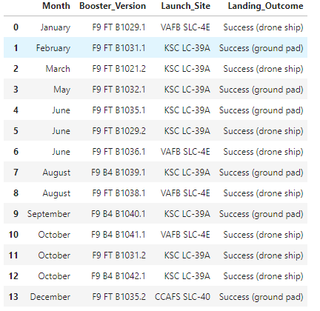
2015 Launch Records
▶ List the failed landing_outcomes in drone ship, their booster versions, and launch site names for in year 2015
▶ (YEAR(CONVERT(date, Date, 105)) = '2015’)

Slide 33
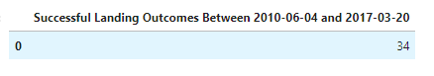
Rank Landing Outcomes Between 2010-06-04 and 2017-03-20
▶ SELECT COUNT(Landing_Outcome)
▶ FROM tblSpaceX
▶ WHERE (Landing_Outcome LIKE '%Success%’) AND (Date > '04-06-2010’) AND (Date < '20-
03-2017')

Slide 34

Section 3

Slide 35
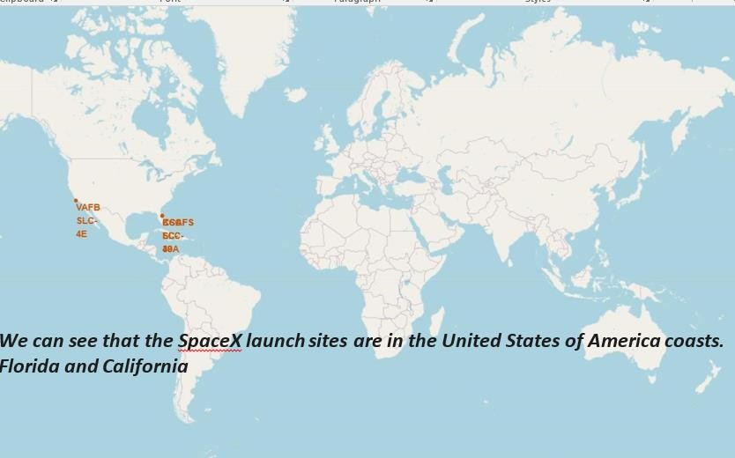
<Folium Map Screenshot 1>
35

Slide 36
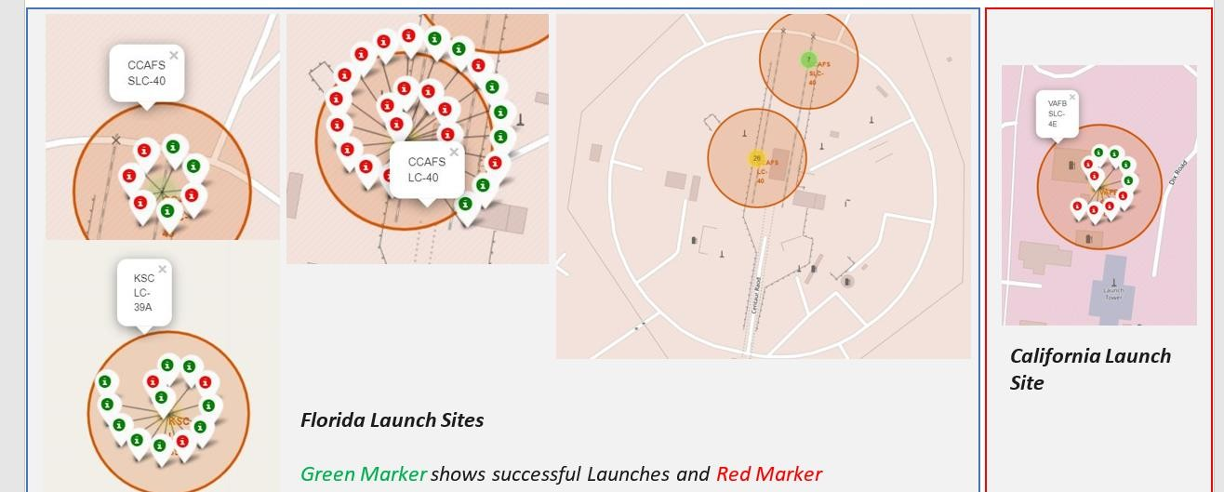
<Folium Map Screenshot 2>

Slide 37
<Folium Map Screenshot 3>
▶ Replace <Folium map screenshot 3> title with an appropriate title
▶ Explore the generated folium map and show the screenshot of a selected launch site to its proximities such as railway, highway, coastline, with distance calculated and displayed
▶ Explain the important elements and findings on the screenshot

Slide 38

Section 4

Slide 39
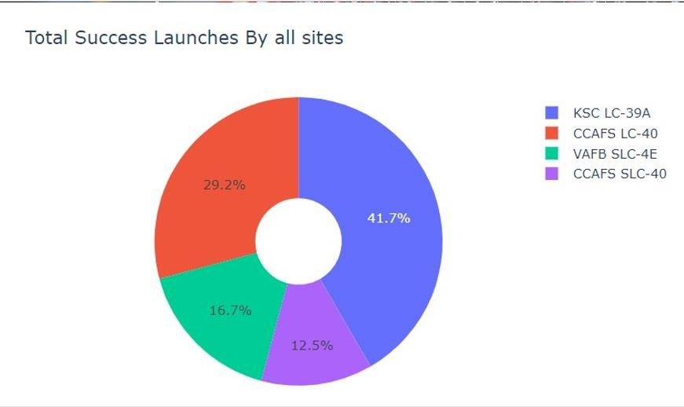
<Dashboard Screenshot 1>
Seeing that KSC LC-39A had
the most successful launches
from all the site

Slide 40
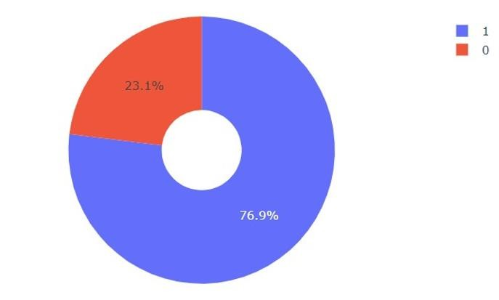
<Dashboard Screenshot 2>
KSC LC-39A achieved a 76.9% success rate while getting a 23.1% failure rate

Slide 41
<Dashboard Screenshot 3>
▶ Replace <Dashboard screenshot 3> title with an appropriate title
▶ Show screenshots of Payload vs. Launch Outcome scatter plot for all sites, with different payload selected in the range slider
▶ Explain the important elements and findings on the screenshot, such as which payload range or booster version have the largest success rate, etc.

Slide 42

Section 5

Slide 43
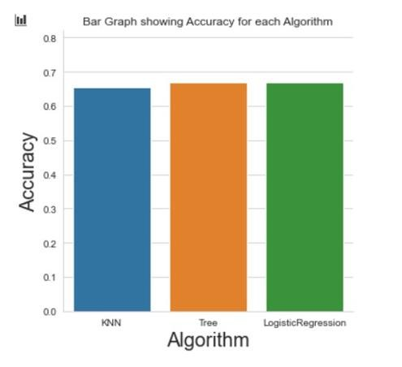
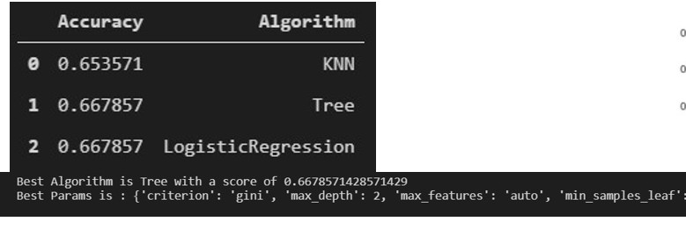
Classification Accuracy
▶ Visualize the built model accuracy for all built classification models, in a bar chart
▶ Find which model has the highest classification accuracy

Slide 44
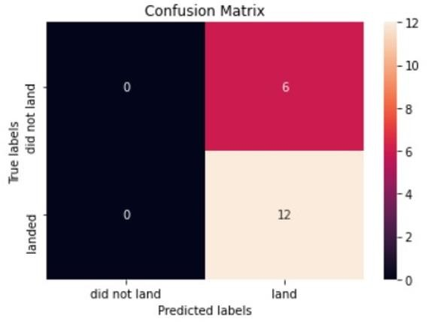
Confusion Matrix
▶ Show the confusion matrix of the best performing model with an explanation

Slide 45
Conclusions
▶ We successfully got our data, cleaned it .
Explored it and buillt a model with it.
▶ We drew conclusions and inferences from our model as well as gained insights.
▶ For more information, please refer to the more detailed work in the links. Shared.
▶ …

Slide 46
Appendix
pandas as pd
from sklearn import preprocessing
import seaborn as sns
from sklearn.linear_model import
LogisticRegression
from sklearn.tree import
DecisionTreeClassifier
mport
!pip install sqlalchemy==1.3.9
!pip install ibm_db_sa
!pip install ipython-sql
SpaceX.CSV
46

Slide 47


